Slide 1
Explain OOPs principles with real project examples.
Encapsulation: Hiding fields using private variables (e.g., User entity fields).
Inheritance: Reusing base classes (e.g., BaseEntity with audit fields).
Polymorphism: Same interface, different behavior (e.g., PaymentService for Card/UPI).
Abstraction: Exposing contracts via interfaces (e.g., NotificationService).
Eat Icecream, Play Alone

Slide 2
Difference between abstraction and encapsulation?
Abstraction defines what a system does (interface).
Encapsulation controls how data is accessed.
Example: Service interface vs private fields.

Slide 3
Difference between method overloading and method overriding?
Overloading is compile-time polymorphism (same method, different params).
Overriding is runtime polymorphism (child changes behavior).
Example: Different findUser() methods vs overridden processPayment().

Slide 4
Can we override a static method? Why or why not?
No. Static methods belong to the class and are resolved at compile time.

Slide 5
Difference between abstract class and interface after Java 8?
Abstract class → share common code Interface → define what a class must do
Abstract Class
Can have state and constructors
Used for shared base behavior
Supports single inheritance
Interface (Java 8+)
No state, no constructors
Supports default and static methods
Used to define contracts
Supports multiple inheritance
Real-world example: Abstract class → BaseEntity Interface → PaymentService

Slide 6
Why is multiple inheritance not supported in Java classes?
To avoid ambiguity caused by the diamond problem.

Slide 7
Explain the role of Object class in Java.
It is the root class and provides equals, hashCode, toString, wait, notify.

Slide 8
Why must equals() and hashCode() be overridden together?
Because hash-based collections depend on both.
HashMap / HashSet first use hashCode() to find the bucket
Then use equals() to find the exact object
If only one is overridden, collections may behave incorrectly
Simple example: Two objects look equal using equals(), but different hashCode() → both get stored as duplicates.

Slide 9
What is the use of functional interface?
It enables lambda expressions and functional programming.
A functional interface has only one abstract method, so Java knows what to execute when you use a lambda.
Example:
@FunctionalInterface
interface Calculator {
int add(int a, int b);
}
Using lambda:
Calculator c = (a, b) -> a + b;
System.out.println(c.add(2, 3)); // 5
Why it’s useful (in simple words)
Lets you write less code
Avoids creating full classes
Makes code clean and readable
One-line explanation:

Slide 10
How to resolve diamond problem in java in interface level?
Use InterfaceName.super.method() to resolve ambiguity.

Slide 11
Difference between JDK, JRE, and JVM?
JVM runs code, JRE provides runtime, JDK provides development tools.

Slide 12
What happens internally when you create an object in Java?
Class loading → memory allocation → constructor execution → reference returned.

Slide 13
Explain the static keyword in terms of memory allocation.
Static variables and methods are stored once in memory at the class level.
Memory is allocated when the class is loaded
Stored in the Method Area
Shared by all objects of the class
Simple example:
class Counter {
static int count = 0;
}
No matter how many objects you create, only one count exists.

Slide 14
Why is static not allowed on local variables?
static is class-level, local variables are method-level—so they can’t be used together.
local variables live only inside a method, but static belongs to the class.
Local variables are created on the stack when a method runs
static variables are created at the class level and live longer
Their lifecycles don’t match, so Java doesn’t allow it
example: A local variable exists only while the method runs, but static should exist even without calling the method.

Slide 15
Explain the class loading process at a high level.
Class loading happens in three simple steps:
Loading – JVM loads the .class file into memory
Linking – Verifies code, allocates memory, resolves references
Initialization – Executes static variables and static blocks
Simple view: Load the class → prepare it → run static code

Slide 16
Why is String immutable in Java?
String is immutable for security, thread safety, and performance.
Security – prevents changes to sensitive data (URLs, passwords)
Thread-safe – same String can be shared across threads
Performance – enables String Pool caching

Slide 17
Difference between StringBuilder and StringBuffer?
StringBuilder → faster, not thread-safe
StringBuffer → slower, thread-safe
When to use:
Use StringBuilder in single-threaded code (most cases)
Use StringBuffer when multiple threads modify the same string

Slide 18
Checked vs unchecked exceptions – when do you use each?
Checked exceptions handle recoverable errors; unchecked exceptions indicate code bugs.
Checked exceptions → use when the error can be recovered
Example: IOException, SQLException
Unchecked exceptions → use for programming mistakes
Example: NullPointerException, IllegalArgumentException
Real-world use:
Checked → file not found, DB down
Unchecked → null access, wrong input logic

Slide 19
What is try-with-resources and why is it preferred?
It automatically closes resources and avoids leaks.
Try-with-resources automatically closes resources after use.
No need for finally block
Prevents resource leaks
Cleaner and safer code
Simple example:
try (FileReader fr = new FileReader("data.txt")) {
// use file
}
The file is closed automatically.

Slide 20
How do you design custom exceptions in Java?
Custom exceptions make error handling clear and meaningful in business logic.
steps:
Create a class that extends Exception or RuntimeException
Give it a meaningful name and message
example:
class UserNotFoundException extends RuntimeException {
public UserNotFoundException(String msg) {
super(msg);
}
}
Real-world use: Thrown when a requested user is not found in DB.

Slide 21
Difference between List, Set, and Map?
List stores duplicates, Set stores unique values, Map stores key–value pairs.
List vs Set vs Map :
List → allows duplicates, maintains order
Example: List of orders
Set → no duplicates, order not guaranteed
Example: Unique user IDs
Map → key–value pairs, keys are unique
Example: User ID → User details

Slide 22
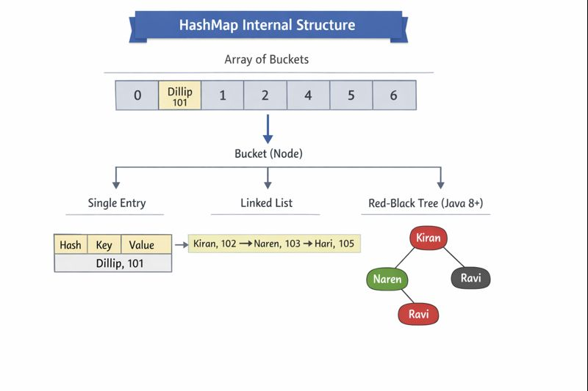


Explain the internal working of HashMap.
HashMap internally uses an array of buckets
Each bucket can store:
One entry
A Linked List
A Red-Black Tree (Java 8+)

Slide 23

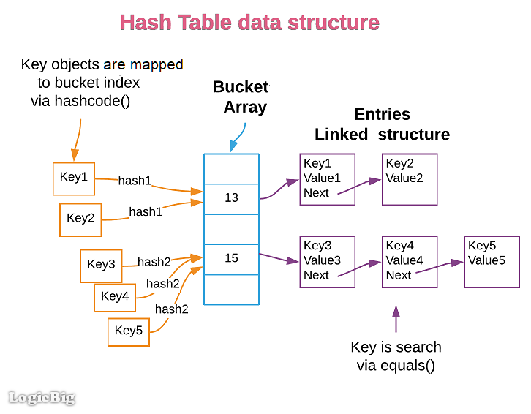

Explain the internal working of HashMap.
map.put("Dillip", 101);
HashMap calls:
"Dillip".hashCode()
Hash value is generated
Hash decides which bucket to use
Hash is converted into an array index
Example:
Bucket[13] → Dillip = 101
If bucket is empty → store directly If bucket already has data → collision
map.put("Kiran", 201); If both produce same Bucket[13] Collision happens
Bucket[13] → Dillip → Kiran

Slide 24
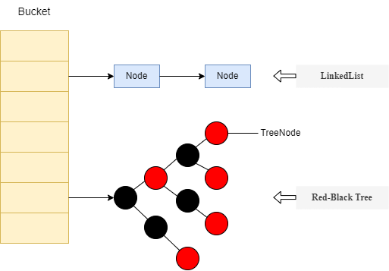
Explain the internal working of HashMap.
map.put("Dillip", 101);
map.put("Kiran", 102);
map.put("Naren", 103);
map.put("Ravi", 104);
map.put("Hari", 105);
map.put(“Madhu", 106);
map.put(“Manu", 107);
map.put(“Manoja", 107);
map.put(“Varun", 108);
map.put(“Jiban", 109);
-----
-----
Bucket[13] → Dillip → Kiran → Naren → Ravi … If entries > 8 and map size ≥ 64

Slide 25
Explain the internal working of HashMap.
How get("Ravi") Works? If Ravi is in Linked List
map.get("Ravi");
Steps:
"Ravi".hashCode() calculated
Bucket index found
Inside bucket:
Compare using equals()
Value returned → 104 If Ravi is in a Red-Black Tree, then what happens?
Case 1️⃣ get("Ravi")
HashMap calculates "Ravi".hashCode()
Finds the bucket
Since the bucket is a Red-Black Tree:
It searches like a tree, not a list
Lookup time becomes O(log n) (fast)
Uses equals() to confirm the key
Returns Ravi’s value
✅ Faster than linked list search
Linked List search → O(n)
Tree search → O(log n) (faster)

Slide 26
Explain the internal working of HashMap.
Case 2️⃣ put("Ravi", newValue)
HashMap finds the same bucket
Tree is searched to find "Ravi"
Since key already exists:
Value is replaced
Tree structure remains the same
Case 3️⃣ New key added (e.g., "Hari")
"Hari" hashes to the same bucket
Entry is inserted into the Red-Black Tree
Tree automatically rebalances itself
HashMap performance stays efficient

Slide 27
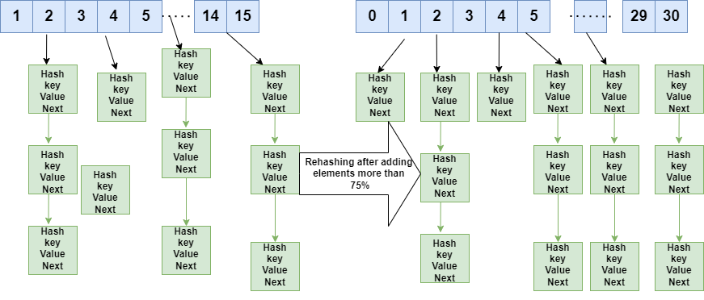
Explain the internal working of HashMap.
Resizing & Rehashing:
Defaults:
Initial capacity = 16
Load factor = 0.75
When size exceeds threshold:
Capacity doubles
All entries (Dillip, Kiran, Naren, Ravi, Hari)
are rehashed
New bucket positions assigned

Slide 28
Difference between HashMap and ConcurrentHashMap?
HashMap is fast but not safe for multiple threads; ConcurrentHashMap is safe and works well with many threads.

Slide 29
Why does HashMap allow one null key?
Because HashMap treats the null key in a special way.
HashMap stores the null key in a fixed bucket (bucket 0)
Since there is only one such special bucket, only one null key is allowed
Multiple null keys would create confusion, so HashMap restricts it to one
example:
map.put(null, "Apple");
map.put(null, "Mango"); // replaces Apple

Slide 30
Explain the internal working of TreeSet.
It uses a Red-Black Tree to maintain sorting.
TreeSet
↓
TreeMap
↓
Red-Black Tree (Self balancing BST)

Slide 31
Explain the internal working of TreeSet.
It uses a Red-Black Tree to maintain sorting.
TreeSet
↓
TreeMap
↓
Red-Black Tree (Self balancing BST)
When you do:
TreeSet<Integer> mySet = new TreeSet<>();
Java actually creates:
TreeMap<Integer, Object> map;
Each element you add to TreeSet becomes a key in TreeMap (with a dummy value like PRESENT).

Slide 32
Explain the internal working of TreeSet.
When you add elements:
Example:
TreeSet<Integer> set = new TreeSet<>();
set.add(40);
set.add(20);
set.add(60);
set.add(10);
set.add(30);

Slide 33
Explain the internal working of TreeSet.
Step 1 — First element becomes root
40
Step 2 — Smaller goes left, bigger goes right
40
/ \
20 60
Step 3 — Keep inserting in sorted position
40
/ \
20 60
/ \
10 30
TreeSet<Integer> set = new TreeSet<>();
set.add(40);
set.add(20);
set.add(60);
set.add(10);
set.add(30);
Tree automatically balances itself
(so, it never becomes long or slow)
This is why operations are O(log n).

Slide 34
Explain the internal working of TreeSet.
How TreeSet avoids duplicates
Before inserting, it compares:
newElement vs existingElement
Using:
• compareTo() OR • Comparator
If result = 0 → ❌ not added (duplicate)

Slide 35
Explain the internal working of TreeSet.
❌ When removing elements:
Remove 20
Before:
40
/ \
20 60
/ \
10 30
After re-balance:
40
/ \
30 60
/
10
(Tree fixes structure automatically)

Slide 36
Difference between fail-fast and fail-safe iterators?
Fail-fast throws exception; fail-safe works on copy.

Slide 37
ArrayList vs LinkedList – performance comparison?
ArrayList is faster for reads; LinkedList for insert/delete.

Slide 38
Comparable vs Comparator – when to use which?
Comparable defines natural order; Comparator defines custom order.

Slide 39
How does TreeSet maintain sorting internally?
Using a Red-Black Tree structure.

Slide 40
What happens if hashCode() always returns the same value?
Performance degrades to O(n).

Slide 41
What is Java Serialization?
Converts object state into byte stream.

Slide 42
Purpose of the transient keyword?
It prevents fields from being serialized.

Slide 43
What are the problems with Java Serialization?
Security risks, performance issues, versioning problems.

Slide 44
Difference between Serializable and Externalizable?
Externalizable gives full control over serialization.

Slide 45
When should serialization be avoided?
In high-performance or security-critical systems.

Slide 46
Difference between start() and run() methods?
start() creates a new thread; run() executes normally.

Slide 47
Explain the thread lifecycle states.
New → Runnable → Running → Waiting/Blocked → Terminated.

Slide 48
What is synchronization and why is it needed?
It prevents data inconsistency in multi-threaded code.

Slide 49
Difference between synchronized method and synchronized block?
Synchronized block gives finer control.

Slide 50
What is deadlock? How can it be prevented?
Threads wait forever; prevent via lock ordering or timeout.

Slide 51
What does the volatile keyword guarantee?
It guarantees visibility, not atomicity.

Slide 52
Difference between volatile and synchronized?
volatile ensures visibility; synchronized ensures mutual exclusion.

Slide 53
Difference between visibility and atomicity?
Visibility means updated value is seen; atomicity means operation is indivisible.

Slide 54
How does ConcurrentHashMap achieve thread safety?
Uses CAS and fine-grained locking.

Slide 55
Why is volatile not a replacement for synchronization?
It does not guarantee atomic operations.

Slide 56
Explain the Singleton design pattern and its problems.
Ensures one instance; issues with threading, reflection.

Slide 57
How do you create a thread-safe Singleton?
Using enum or double-checked locking.

Slide 58
Why is Enum Singleton preferred over other approaches?
It is safe from reflection and serialization.

Slide 59
Difference between Factory and Abstract Factory patterns?
Factory creates one object; Abstract Factory creates families.

Slide 60
Where have you used the Abstract Factory pattern in real projects?
Used in payment gateways, notification systems, or multi-DB support.

